Slide 1


Microsoft AI Innovation Challenge 2026
From raw data to intelligent decisions Design

Slide 2
Expelexia Lab Assistant
AI‑Powered Lab Notebook Assistant Analyze data, interpret results, and plan safe next steps.

Slide 3


NeuraForge Team
Henok Tariku
Rocio Herrera
Team Member and Leader
Role: Junior Data Analyst & Software Engineer
Skills: Data Analysis, Software Engineering, API Integration, Machine Learning, Automation, Python, Power BI, Cloud (Azure)
Location: Moscow, Russia
Team Member
Role: Cybersecurity & AI Enthusiast
Skills: Cybersecurity, Artificial Intelligence, Problem Solving, Data Analysis, Risk Assessment
Location: Los Angeles, USA

Slide 4
The Problem
IoT systems generate massive datasets
Manual analysis is slow and error-prone
No easy way to generate insights & reports

Slide 5
Our Solution
AI-powered data analysis platform
Automated processing → insights → reports
Simple interface for complex data

Slide 6
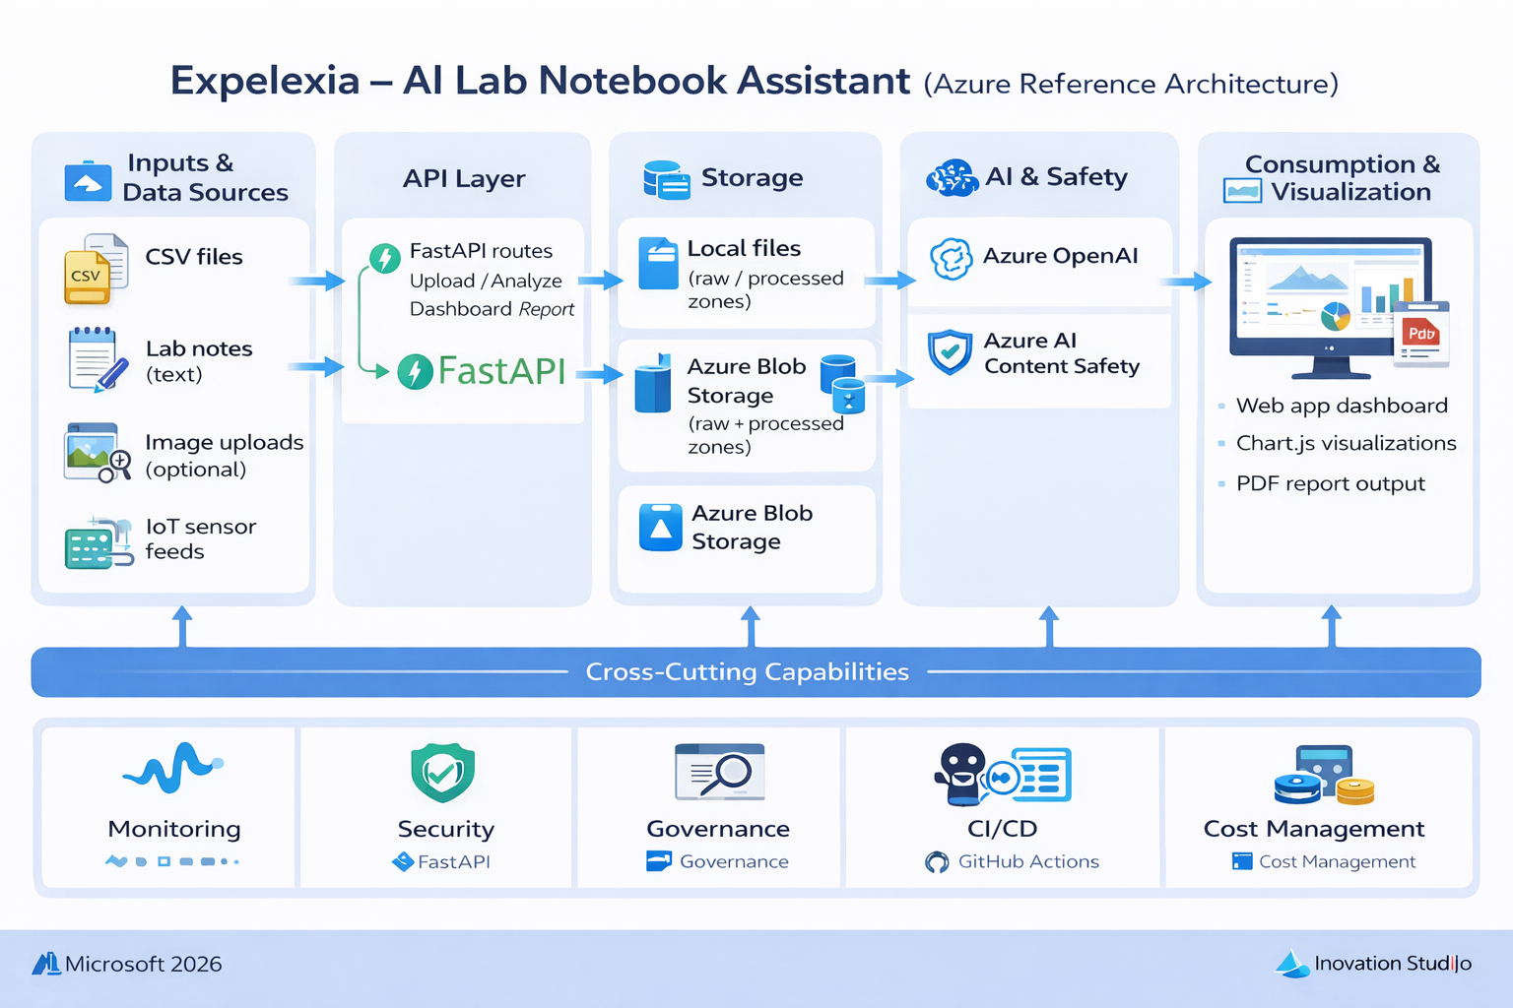
Key Features
Upload CSV/PDF
AI analysis
Dashboard
Report generation

Slide 7
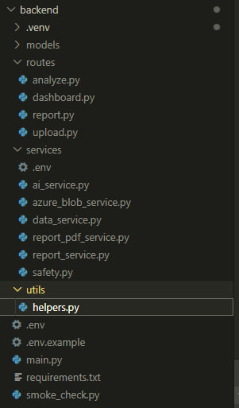

Backend Overview
FastAPI backend
API routes:
/api/upload
/api/analyze
/api/report
Azure + AI services

Slide 8
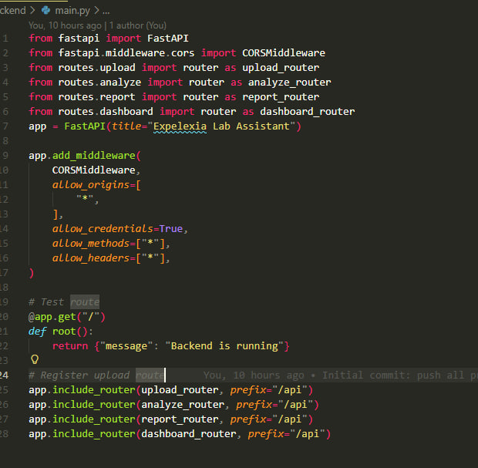
Backend Code Example

Slide 9
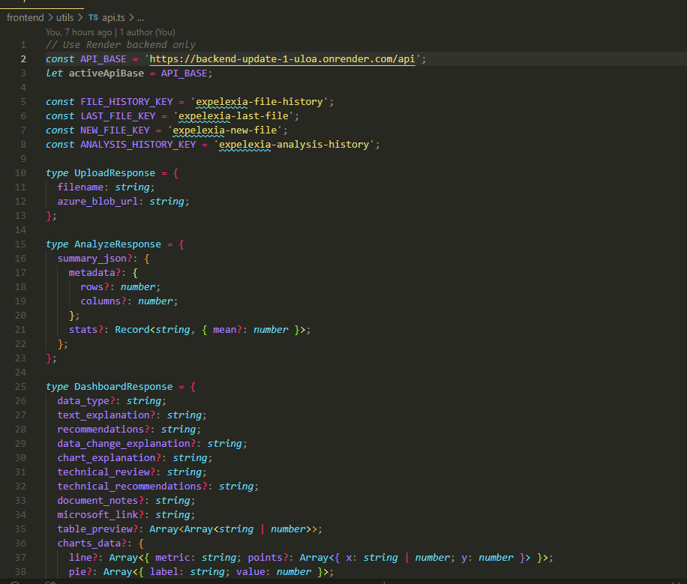
Frontend Overview
Next.js + React
UI for upload & dashboard

Slide 10
API Communication
Frontend
Backend
Response
Frontend calls backend: fetch(${BASE_URL}/api/upload)
Backend processes & returns JSON

Slide 11
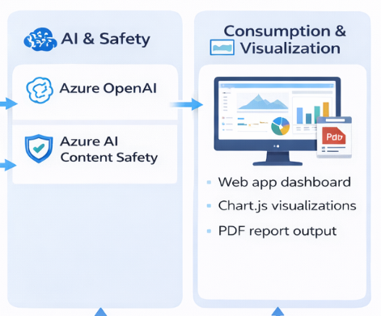
AI Analysis
Azure OpenAI analyzes data
Detects patterns & anomalies
Generates recommendations

Slide 12
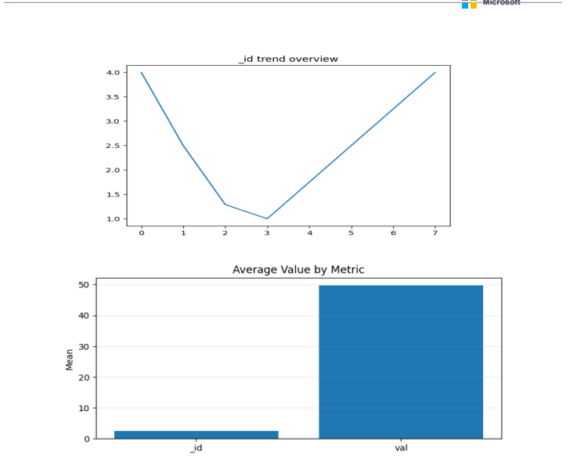
Dashboard
Charts & metrics
Data visualization
Real-time insights

Slide 13
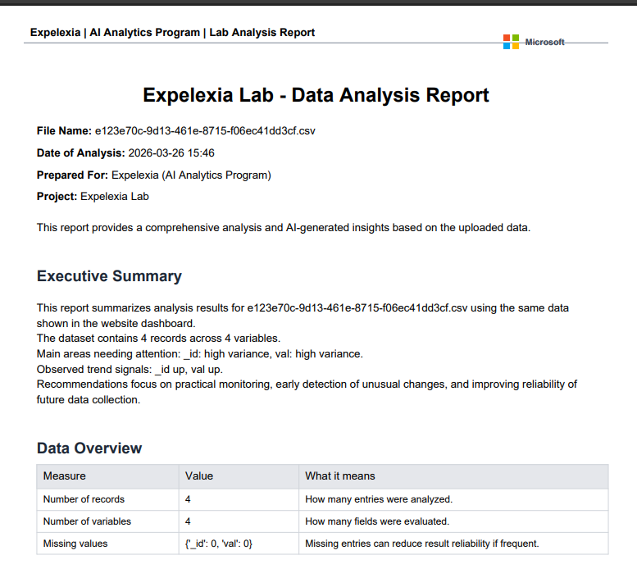
Report Generation
PDF reports generated automatically
Uses:
Reportlab
pandas

Slide 14
Deployment
Backend:
Render
Gunicorn + Uvicorn
Frontend:
Netlify
URLs: https://backend-update-1-uloa.onrender.com/api
Backend: onrender
Frontend: netlify

Slide 15

Challenges & Fixes
API not connecting → fixed URL
CORS issues → middleware
Azure auth errors → env variables
Deployment issues → gunicorn fix

Slide 16

Final / Conclusion
Expelexia automates lab data analysis
AI-powered insights
Full-stack deployed system
GitHub link: https://github.com/Adam-7th/Expelexia
Demo link: https://expelexialab.netlify.app/

